Slide 1


GERMISTON HIGH SCHOOL
Covid-19 training manual

Slide 2
Learners’ Orientation

Slide 3
WHAT IS COVID-19?
On 31 December 2019, the World
Health Organization (WHO) China
country office reported a cluster of
pneumonia cases in Wuhan City,
Hubei Province of China. Severe acute
respiratory syndrome associated with
a novel coronavirus were confirmed.
The virus has been named “SARS-CoV-2” and the disease caused “coronavirus disease 2019”, or COVID-19

Slide 4
HOW IS COVID-19 SPREAD?
COVID-19 is spread by fluid droplets when coughing, sneezing or shouting and can be spread by a person who has been infected before symptoms occur, during illness and for a short period of time after they feel better.
Researchers estimate that around 44% of infections are passed on by people who are not showing any symptoms
Virus particles can survive in the air for a short period of time and can remain on hard surfaces such as plastic or steel for a few days, if not removed with regular cleaning.
COVID-19 is spread by contaminated hands touching the hands of others and touching things such as money, books, stationary, door handles and counters.
When you then touch your eyes, nose and mouth after you have touched other people’s hands and things with COVID-19 on it, then you can get infected.
Because Coronavirus is a new virus, there is currently no vaccine available. However, many of the symptoms can be treated

Slide 5
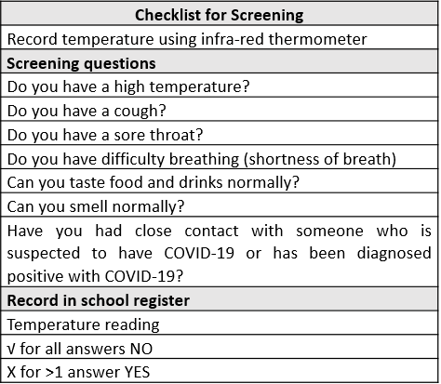
Screening questions for learners

Slide 6
Testing for COVID-19
What happens if a learner is identified through screening?
If a learner has a high temperature or has been found to have a symptom they will be asked to wait in a designated waiting area in the school.
Each learner identified must continue to wear a face mask and must continue to adhere to the physical distancing rules.
The waiting area will be a private room (with no thoroughfare possible) that is big enough to seat a number of learners with chairs that are well spaced. The learner will be asked to wait here to be instructed on the process for triage and possible testing.
The Screening Team will need to inform the Professional Nurse that learners have been isolated at the school.
At this point the parents/carers should be contacted by SMT/SBST.
Further assessment of learner (“triage”) will be necessary to determine if the learner requires a COVID – 19 test.
Triaging can be conducted in the school whilst the learner is waiting or at the testing facility they are referred to.
Ideally all learners should be referred and transported to the nearest testing facility (for triage and possible testing)
Transport for the learner will be arranged.

Slide 7
STANDARD PRECAUTIONS OF INFECTION PREVENTION AND CONTROL
A safe environment can be achieved through elimination of infectious particles
in the air and on surfaces by always adhering to the Golden Rules:
1. Prevent direct contact with persons who are sick – encourage
educators, learners and staff to stay at home when feeling sick.
2. Use of personal protective equipment (PPE) – use protective face masks
at all times.
3. Environmental cleaning and disinfection - reduce the risk of microorganisms
in the environment by cleaning and disinfecting frequently
touched surfaces such as door handles, hand rails, desks, tables, windows,
etc. hourly or less frequently depending on the circumstances.
An effective disinfectant is diluted bleach disinfectant (20 ml bleach per litre of
clean water).
4. Social distancing - Keep a distance of at least 1.5 meters between persons
where possible, avoiding gatherings and contact activities outside of the
classroom such as extra mural activities, contact sport, assemblies, hall
gatherings and queuing at tuck-shops or for school feeding programme
meals.
5. Hand hygiene - Wash hands frequently with soap and water for 20
seconds, especially after using the toilet, touching food and if hands are
visibly soiled/dirty.
6. Use alcohol-based hand sanitiser regularly, especially after contact with
any person or after contact with frequently touched surfaces i.e. phones,
door handles etc.

Slide 8
7. Avoid touching your eyes, mouth, or nose with unwashed/un-sanitised
hands.
8. Limit airborne transmission- allow adequate cross ventilation in
classrooms and office buildings. Limit visitors and the number of people that
enter the school, office or classroom. Parents should enter the school only
if absolutely necessary.
Practice cough and sneeze etiquette – cough in the fold of the bent elbow
and sneeze in a tissue which should be discarded safely in a refuse bin with
a lid. Wash hands immediately thereafter.
C. RISK REDUCTION METHODS FOR SCHOOLS
a) Every person (parent, teacher, learner or visitor) that enters or leaves a
school must wash their hands or sanitise them at the entrance/gate utilising
hand hygiene stations equipped with soap (bar or liquid) and water or
sanitise with a hand sanitiser with at least 60% alcohol base.
b) Pens and pencils must not be shared amongst learners or teachers.
c) There should be no sharing of food or eating utensils.
d) Social distancing must be adhered to at all times.
e) Classrooms must be well ventilated.
f) Classrooms must be cleaned at least twice a day with a disinfectant.
g) Every person (parent, teacher, learner or visitor) that enters a school should
have their temperature assessed with a digital thermometer scanner as
follows.
o Remove the protective scanner cap
o Switch the scanner on and wait for the ‘00’ reading
o Scan the forehead of the person
o A reading of 38 degrees Celcius and above indicates a possible fever and
should be referred for further investigation, as per the DBE Standard
Operation Procedure for the Prevention, Containment and Management
of COVID-19 in Schools and School Communities- hereafter referred to
as the “SOPs”)

Slide 9
o Visitors and staff with a fever are not permitted on the school grounds.
o Learners with a temperature of more than 38 degrees must be kept
separate from other and isolated in the designated isolation space,
equipped with a mask and the parents/caregivers notified to collect the
child for further investigation by a health professional. The principal or
his/her designate must contact the school health contact person or the
nearest public primary healthcare facility. The health facility must be
informed if a COVID-19 infection is suspected so that the facility can
make the necessary arrangements to receive and manage the
patient safely to prevent contamination.
NB: Each person conducting screening must wear a face mask and must
regularly wash their hands for 20 seconds or use a hand sanitiser (at least
60%alcohol) during the course of screening. Social distancing must be
observed at all times.
HAND HYGIENE PRACTICES
a) When to wash hands
Wash your hands after visiting the toilet;
Wash your hands before handling food or eating;
Wash your hands after taking care of sick people;
Wash your hands after touching surfaces;
Wash your hands after sneezing or coughing.

Slide 10
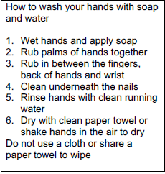
How to wash hands

Slide 11
How to sanitise hands
1. Apply the hand sanitiser to the palm of one hand (size of a R1/or R2 coin)
2. Rub your hands together
3. Rub the gel over all the surfaces of your hands and in between fingers
for at least 20 seconds until your hands are dry
A Note on alcohol-based hand sanitisers
If you are not near a handwashing station and soap, use a hand sanitiser to
clean your hands.
Do not use a sanitiser after using the toilet and if your hands are visibly soiled -
wash hands with soap and water.
Sanitisers should have alcohol content of at least 60% for maximum protection.
No more than 60% is required.
Use a hand sanitiser only on dry hands.
If using gloves, sanitise hands before and after use (of the gloves).
Do not use a sanitiser on gloves.
Do not sanitise and use water at the same time – it is harsh for your skin.

Slide 12
USE OF INFORMATION, EDUCATION AND COMMUNICATION
MATERIAL
Advocacy material on handwashing must be available and displayed
prominently in each classroom, hall, toilet facility and office building.
Important information messages for schools should include the following:
o Wash hands and sanitize hands frequently.
o Avoid touching eyes, nose and mouth.
o Cover the mouth and nose with your bent elbow or tissue when coughing
or sneezing, then dispose of the used tissue safely in a bin with a lid.
o Maintain at least a one and a half meter distance between yourself and
others.
o Use a cloth mask or visor at all times while at school, on the way home
and in public.
o Change masks daily and wash them.
o Do not share pencils, pens, toys and other learning objects.
o No hugging, touching, kissing or shaking hand. Rather elbow greet or foot
tap.
o Do not share food and school lunch amongst friends.
o Do not share eating utensils amongst learners.
o Change clothes daily and wash them.
o Wash daily- take a shower, bath or bathe every day.
o Do not share tooth brushes or face cloths with anyone
o Do not share utensils of sick people with others.

Slide 13
Access and exit will be controlled via the service road gate only.
The green markers are to be used to control social distancing of 1.5m, while queuing to be screened prior to entry.
No person without a mask will be granted access onto the property.
All persons will be expected to complete and sign a detailed register upon entrance, for tracing purposes. The gate will only be opened between 6:30 and 7:00 to allow for the safety personnel to be positioned for screening and register purposes. No entrance will be allowed if the safety personnel are not present. Please be aware that the screening and registration process takes time. School starts at 7:40.
Learners are to proceed directly to either the assembly quad and/or the outside tables, where they are expected to maintain social distancing by using the green markers as guides until the commencement of the first period. All movement deemed necessary, such as going to the bathroom, must be guided by the use of the designated green markers.
Visitors will ideally need to make appointments telephonically or via email in order to gain access. 011 827 8860 / info@germistonghs.co.za
A maximum of 8 visitors will be allowed onto the property at any given time. All individuals will firstly sanitize their hands. Secondly, their temperature will be taken. If it exceeds 38 degrees they will be asked to vacate the property and seek medical attention. They will be expected to inform the school of the outcome of their medical examination. If the person is a learner his/her parents will be contacted to fetch him/her. The learner will be placed in the Quarantine Room until collected by his/her parent. Ideally, the parents should remain until their children are approved for entry into the school. The child may want to notify the parent once approved to enter. The front foyer of the main hall has been designated for this purposes. The relevant health authorities will be notified. If the person’s temperature is below 38 degrees, he/she may proceed directly to the main reception after receiving his/her token. He/she must report to the main reception and thereafter seat himself/herself under the gazebo and wait to be called, unless otherwise instructed by the administrator.
No vehicles, except for staff, GDE officials and service providers, will be allowed onto the property.
All learners are to be dropped off and fetched outside the school’s top gate of the service road.
Learners must immediately vacate the premises at the end of the school day. No dawdling and loitering will be tolerated. The same gate used to enter the school will be used to exit. Social distancing must be maintained at all times.
Parents are advised to check that the means of transport used by their children is compliant with health and safety protocols.

Slide 14

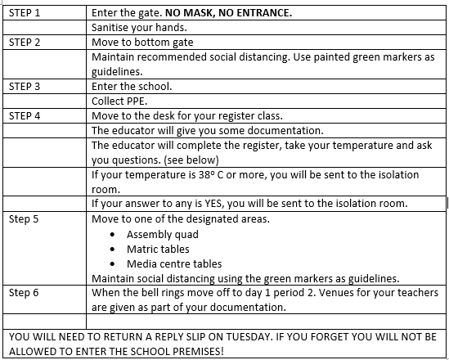
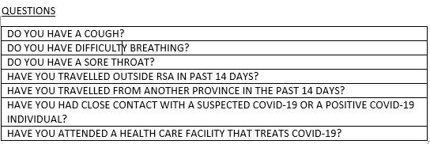
ENTERING THE SCHOOL
PROCEDURES
MAINTAIN RECOMMENDED SOCIAL DISTANCING AND WEAR A MASK AT ALL TIMES!

Slide 15
VENUE RULES
No mask, no entry.
Sanitize as you enter the venue.
There is absolutely no sharing of anything.
Do not move the desks or chairs.
Sit in your allocated seat – you may not switch seats.
Keep your space tidy and clean.
All other school rules apply.

