Slide 1


GERMISTON HIGH SCHOOL
Covid-19 training manual

Slide 2
GERMISTON HIGH SCHOOL
Covid-19 training manual
Parents

Slide 3
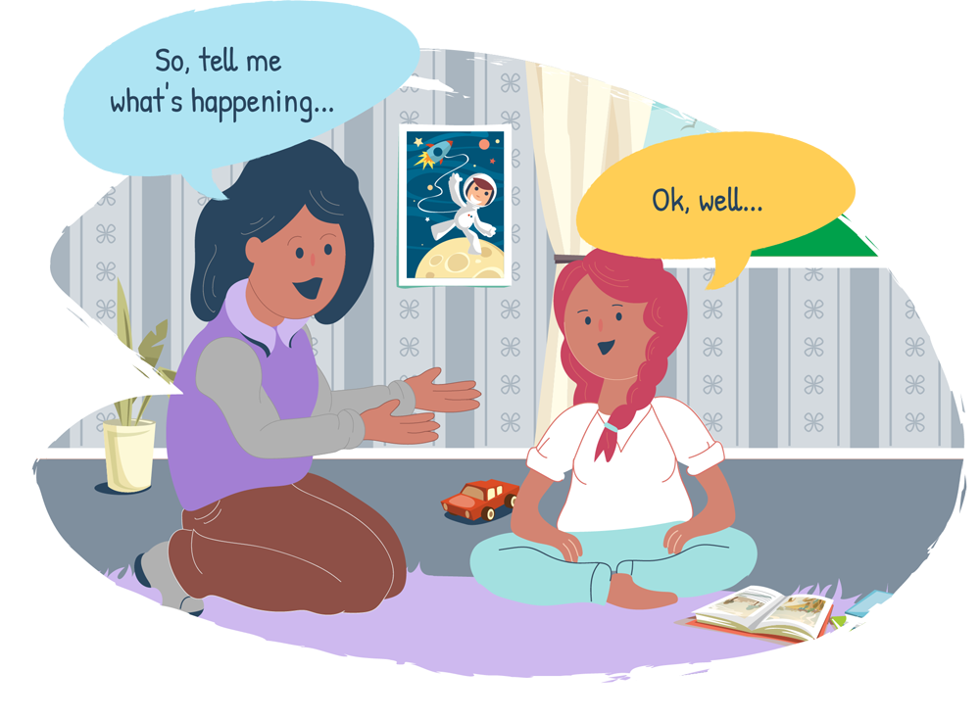
Connect with your children
As parents and guardians, it is always important to connect with your children. But under
conditions of stress or crisis, it is more important than ever to talk to your children, and
to notice their behaviours. This is a time of great change and uncertainty for all people.
Teenagers are at a phase in their lives when their friends and social connections are especially
important to them, and lockdown due to COVID-19 has made this very difficult for them.
Teenagers are also vulnerable to the effects of stress, anxiety and depression during this time.
What can parents do about this?
1 Start by asking your children what they know about the virus and the lockdown, and how hey feel about these events.
• Show your children that you are giving them a safe space to openly and honestly share
their thoughts. Listen attentively as they speak. Do not interrupt, do not correct what
they are saying, do not laugh at or ridicule your children, and do not cut them off.

Slide 4
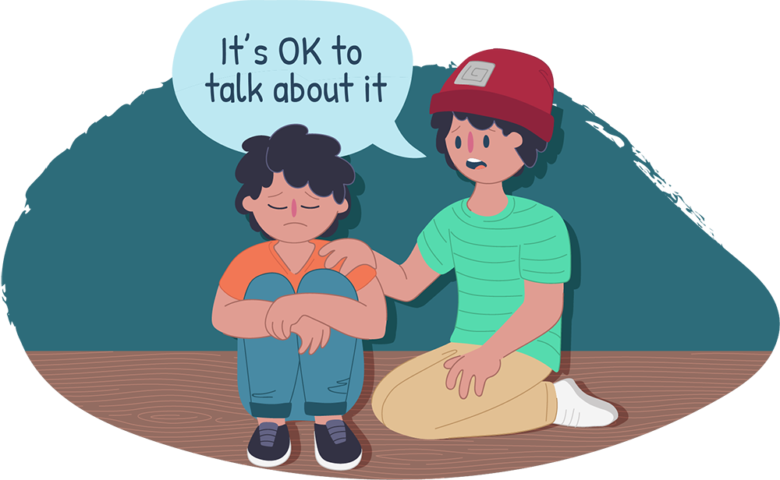
• If children answer your questions with short or one-word answers, gently ask some probing questions, to encourage them to talk more. For example: ‘What do you meanly that?’ or ‘Can you tell me more about…’
• Be patient. Many children will ‘blame’ their parents, and direct their frustration, anger, disappointment and boredom towards you.
• As your children speak, make mental notes of their misconceptions about the situation and of their emotional states.
2 Next, give children accurate, age-appropriate information to correct misconceptions, reduce anxiety, and to give them hope.
• Keep the information that you share simple but accurate.
• Share this information in a calm, clear manner.
• Do not make promises that you cannot keep, for instance, that you will not catch the virus. However, you can give them reassurances that you will try your very best to stay safe, and to keep your children safe.
• Give your children hope. Talk about the fact that this will end, that the scientists and doctors will find a way to fight the virus, and that our lives will eventually go back to normal.
• Answer your children’s questions as best as you can. Admit when you do not know something. Say something like: ‘That is a very good question. I don’t know the answer, but I will try to find out.’
• Try to clear up any misconceptions or misunderstandings that your children may have about the virus or about the lockdown.

Slide 5

Explaining the virus and lockdown to young
children
• A virus is an illness, like flu or measles.
• There is a new virus in the world, called the Corona
Virus.
• Because it is a brand-new virus, the doctors and
scientists need some time to learn about it, so that
they can stop this virus from making people sick.
• To give the doctors and scientists some time to learn
about the virus, we all need to stay home for a while.
• Then, once the doctors and scientists say it is okay,
we will slowly start to go back to school and work, so
that we all stay safe.

Slide 6
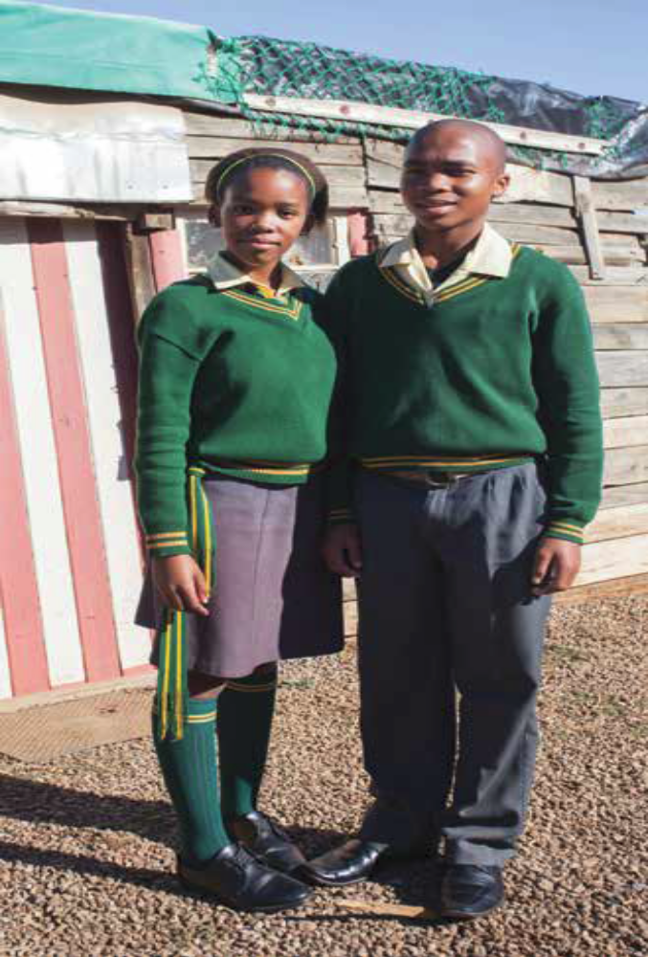
Explaining the virus and lockdown to
pre-teens and teens
Note: Use your discretion to decide how much
information to share with your children. You do not want to raise their stress or anxiety.
• A virus is an illness, like flu or measles.
• There is a new virus in the world, called the Corona Virus, or COVID-19. This stands for Corona Virus Disease of 2019.
• The virus spreads between people who are in close contact with one another, like when an infected person coughs or sneezes. It can also be spread when you touch an infected surface or object, for instance, if someone has sneezed on a table, then you touch the table and transmit the virus to yourself through touching your mouth, nose or eyes.
• This virus affects people in different ways:
• Some people have the virus, but they don’t feel sick at all. We say they are asymptomatic.
• Most people feel sick for a week or two. They usually have a temperature, aches and pains in their body, and may have a cough. Then, they recover and are completely fine.
• A small percentage of people become very ill, and may need to go to hospital for a while.
• People younger than 18 are less likely to have symptoms, and less likely to get very sick. If they do get sick, they usually recover well.
• Because this is a new virus, doctors and scientists need some time to learn about it, so that they can develop a vaccination and better treatments.
• To give the doctors and scientists time to learn about the virus, we all need to stay home for a while.

Slide 7
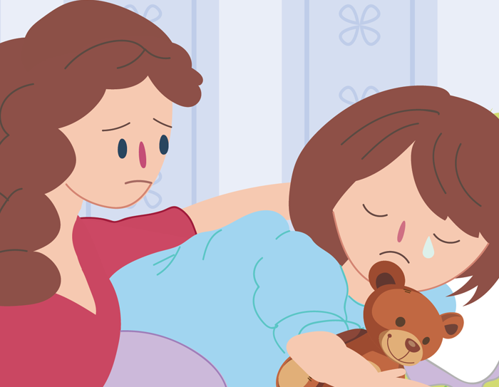
• This lockdown period also gives our government time to prepare our public health system– to train hospital staff and put proper systems in place, to buy enough equipment for all hospitals, and to hire as many hospital staff as possible.
• Once the spread of the virus is under control, and our hospitals are ready to care for many sick people, the lockdown may slowly be lifted.
• People will start going back to work and school in a staggered manner – not all at once.
• Many of us will still have to be tested, and there will still be many rules to follow to ensure that the virus stays controlled.
3 Look for warning signs that your child is not coping. (Some of these warnings are more likely
to be seen in teenagers.)
• Feeling sad or crying when there is no apparent reason
• Anger and frustration when there is no apparent reason
• Not taking part in activities they would usually enjoy at home
• Loss of interest in spending time with family or friends via social media
• Arguing or fighting with family or friends on social media
• Tiredness and loss of energy
• Sleeping too much or struggling to sleep
• Changes in appetite
• Angry outbursts, disruptive or risky behaviour
• Self-harm (e.g. cutting, burning, or otherwise hurting themselves)

Slide 8
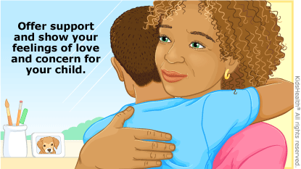
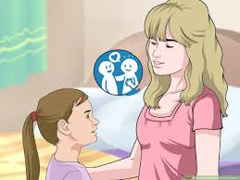
Dealing with children and teens who are not coping with lockdown
• Talk to your children about aggressive or negative behaviour that you would like changed and give them clear alternatives for what you would like them to do instead.
• When their behaviour changes for the better, give them positive feedback about what you see (e.g. When you spoke calmly to me, I really appreciated it).
• Give your children a lot of love. Tell them that you love them. Listen to them when they talk to you. If you are in lockdown together, give them hugs and show physical affection.
• Give your children hope – talk about life after lockdown. Talk about seeing their friends again, about going back to school, about playing outside, and about their plans and dreams for the future.
• If the situation does not improve or even gets worse, reach out to one of the many helplines available.

Slide 9

Routines make life feel safer and more normal
As parents and guardians, we need to build a sense of security and normalcy for our children
as they wait to return to school. We need to keep our children connected to their ‘normal
lives’ by encouraging them to do as many of their regular activities as possible.
What can parents do about this?
1 Work with your children to structure a routine that works for your family.
• Sit down with some paper and a pen and hold a discussion with your children about
routines.
• Explain that routines will make life easier for everyone in the household, with fewer
arguments and conflicts.
• Also explain that lockdown is stressful for you as parents, and that having your
children’s co-operation will support and help you enormously.
• Talk about the kinds of activities that should be included in a daily routine. Encourage
your children to suggest these activities. Remind your children that they will return to
their ‘normal lives’ and they must not lose their knowledge and skills during this time.
• Explain that depending on the ages of your children, they may have different routines.
• Make sure that your children’s routines also work for you. Ensure that children do
some of the chores that need to be done and that meals take place at times that suit
the whole family.
2 Work with your children to ensure that they follow their routines.
• Once routines are designed, ask your children if they accept their routine, and if they
will try their best to follow the routine.
• Make a simple chart of each child’s routine or get each child to make his/her chart.
• Display these charts somewhere that they can easily be seen.
• For the first few days, ‘train’ your children to follow their routines by reminding them
to check their routines, and by following up to see that they are doing all activities.
This will be hard work at first, but it will make your life easier in time.
• Every few days, hold a meeting to see if your children are following their routines.
• If not, discuss the reasons why. See if you need to make any small changes to the
routines.
• Do not be too strict or rigid about the routines – do not add to your stress. But do have
some consequences if one of your children is not trying to follow the routine at all.

Slide 10
Before going to school each day:
  Hygiene – personal responsibility
    Caregivers to do a ‘physical check-in’ on their children on a daily basis before school to assess for any symptoms of any illness – do not send child to school if ill with any symptoms
    Caregivers to provide clean cloth mask (mandatory according to regulations)
    Caregivers to select appropriate transport choices for learners aligned with regulations [see guidance on public transport regarding adequate ventilation, sanitization and reduced capacity in public transport conveyances (bus, train, taxi)]
    Staff to do a ‘physical check-in’ on themselves on a daily basis before school to assess for any symptoms of any illness – do not attend school if ill with any symptoms
    If child or caregiver or staff diagnosed with COVID-19, to alert school to allow for contact tracing, and to follow national guidance for self-isolation
    If child or caregiver has been in contact with an individual with a suspected of confirmed COVID-19 infection, to inform school and to follow national guidance for self-quarantine

